Slide 1
CSC 101 Introduction to Computing Lecture 4
Dr. Iftikhar Azim Niaz
ianiaz@comsats.edu.pk

Slide 2
Last Lecture Summary I
Parts of the Computer System
Hardware
Software
Data
People
Information Processing Cycle
Input
Processing
Output
Storage

Slide 3
Last Lecture Summary II
Computer Hardware
Processor, Memory, Motherboard
Input Devices
Output Devices
Communication devices
Storage Devices
Magnetic storage devices, Floppy Hard disk
Optical storage devices, CD, DVD, Blu Ray
Computer Software
System software and Application software
Computer Users

Slide 4
Using the input devices
CPU is computer brain the input devices are its sensory organs
From user point of view, input device are important
Enables user to enter information and commands into the computer
Two common input devices
Keyboard
Mouse

Slide 5
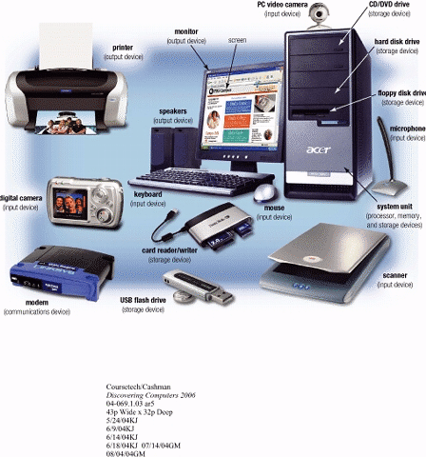
Input Devices
Hardware used to enter data and instructions

Slide 6
Two Common Input Devices
Keyboard
Mouse

Slide 7
The Keyboard
First peripheral to be used with computers
The most common input device for inputting text and numbers
About 100 keys
Must be proficient with keyboard
Skill is called keyboarding

Slide 8
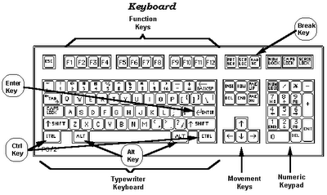
Standard Keyboard Layout
IBM Enhanced Keyboard with 101 keys

Slide 9
Five Groups of Keys
Alphanumeric Keys
Modifier Keys
Numeric Keypad
Function Keys
Cursor Movement keys

Slide 10
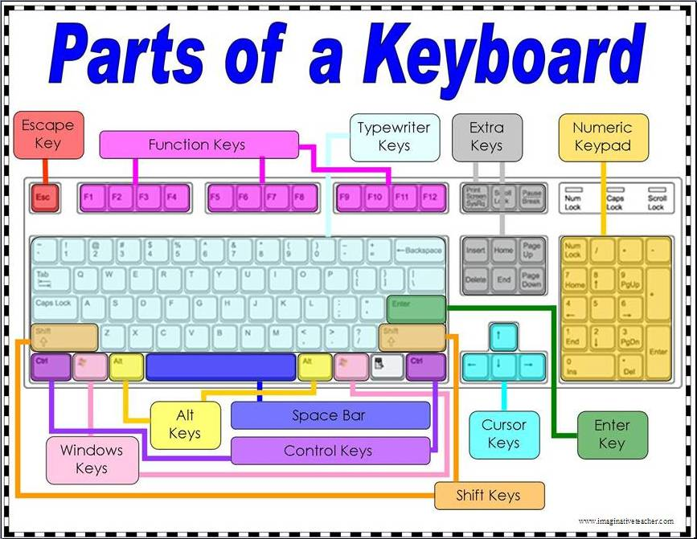

Slide 11
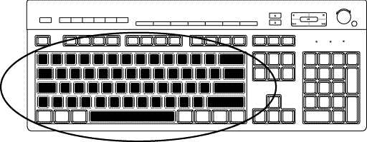
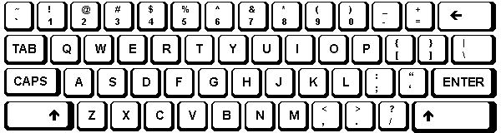
Alphanumeric Keys
Area of computer that looks like a typewriter
Sometimes called QWERTY
Keys having specific functions
Tab
Caps Lock
Backspace
Enter

Slide 12
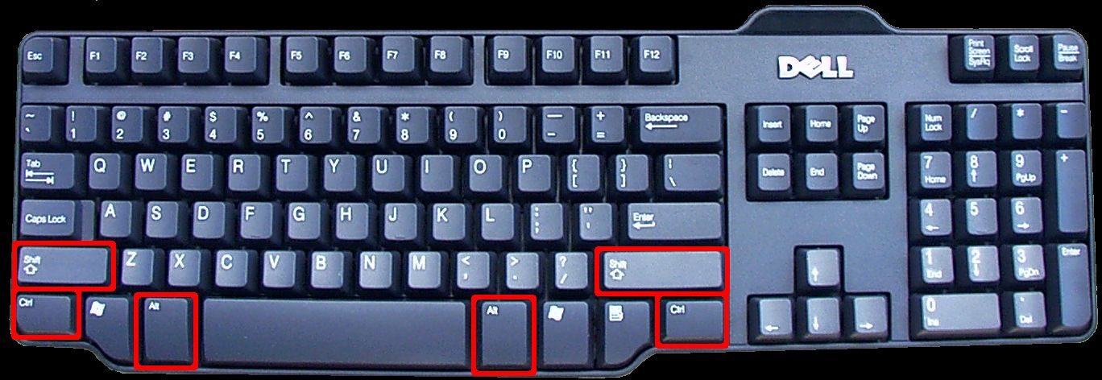
Modifier Keys
Shift
Alt (Alternate)
Ctrl (Control)
Modify the input of other keys
Notes:
A modifier key is a key that modifies the action of another key when the two are pressed together. Modifier keys are commonly used to enter keyboard shortcuts. Common modifier keys include Shift, Control, Alt, Command, Option, and Function.

Slide 13
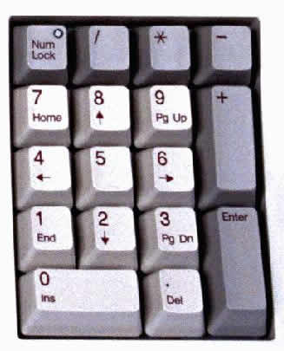
Numeric Keypad
usually located on the right side of the keyboard,
Has 10 digits and mathematical operators (+, -, *, and /).
also features a NumLock key
On - forces the numeric keys to input numbers.
Off - perform cursor movement control and other functions.

Slide 14
Function Keys
labeled F l, F2, and so on
in a row along the top of the keyboard.
allow you to input commands without typing long strings of characters or navigating menus or dialog boxes.
Each key's purpose depends on the program you are using.
Many programs use function keys along with modifier keys to give the function keys more capabilities.
Notes:
F5 – Refreshes or reloads the page or document window.

Slide 15
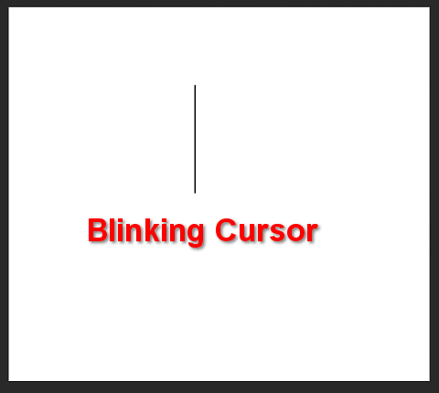
Cursor Movement Keys
let you move around the screen without using a mouse.
Cursor is a mark on the screen indicates where the characters you type will be entered
Arrow Keys
Home and End
PgUp and PgDn

Slide 16
Special Purpose Keys
Esc (Escape)
Insert
Delete
PrtSc (Print Screen)
ScrLk (Scroll Lock)
Pause
Two special for Microsoft Windows
Start
Shortcut

Slide 18
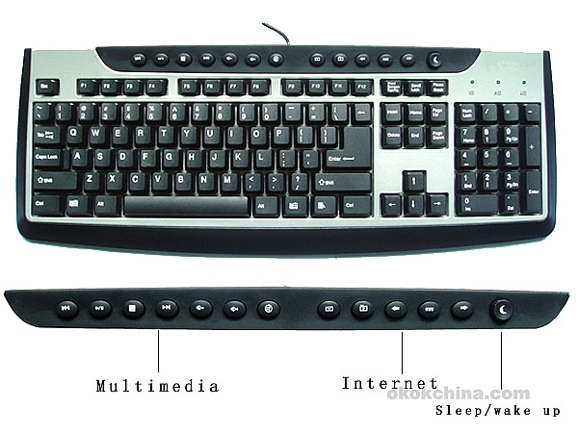
Internet and Multimedia Controls
One of the latest trends is the addition of Internet and multimedia controls.
Microsoft's Internet Keyboard and MultiMedia Keyboard,
e.g. you can use the buttons to launch a Web browser, check e-mail and start your most frequently used programs.
Multimedia buttons
control the computer’s CD-ROM or DVD drive
adjust the speaker volume

Slide 19
How Keyboard Works
Key is pressed on keyboard
Keyboard controller detects a key press
Keeps the code in its memory, Keyboard buffer
Code represents the key pressed
Controller notifies the operating system via an interrupt
Operating system responds the interrupt by the reading the code from buffer
OS passes the code to CPU
Notes:
Teaching tip
Table 5A.3 presents the ASCII code. An exercise that never fails to amuse students is to use the Alt and the number pad to enter letters into an application. As before, open MS Word. Have students hold down the Alt key and type an ASCII value into the number pad. Once they release the Alt, the letter appears. This is a useful skill when the keyboard breaks. Challenge the students to explore numbers above 128.
How do keyboards work?
Step 1 – The user presses a key on the keyboard
The carbon pad on the base of the key hits the circuit board, completing the circuit
Step 2 – The keyboard detects a keypress
The microcontroller in the keyboard detects which key that has been pressed by sending electrical pulses through the circuits running under the base of each key.
Step 3 – The keyboard sends the scan code to the computer
The microcontroller sends an interrupt signal via a USB serial connection (or Bluetooth) to the computer, informing the processer that a key has been pressed together with the scan code of the key(s) that was pressed.
Step 4 – The scan code is converted to the letter/number that was pressed.
The operating system converts the scan code into the binary code for letter / symbol that was pressed, depending on the keyboard language installed on the operating system.
Step 5 – The letter is passed to the software
The operating system passes data onto the software to be handled as required (for example displaying a letter on screen or turning a player’s character in a game)

Slide 20
Dvorak Keyboards
For people who type with one hand or finger
Reduce the amount of motion required to type common English text
Increase typing rate
Reduced errors
But Qwerty is still popular
Notes:
Dvorak is a keyboard layout for English patented in 1936 by August Dvorak and his brother-in-law, William Dealey, as a faster and more ergonomic alternative to the QWERTY layout (the de facto standard keyboard layout). Dvorak proponents claim that it requires less finger motion^{[2]} and as a result reduces errors, increases typing speed, reduces repetitive strain injuries,^{[3]} or is simply more comfortable than QWERTY.

Slide 21
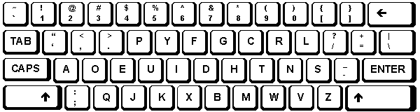
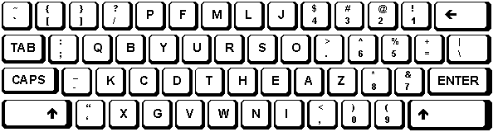
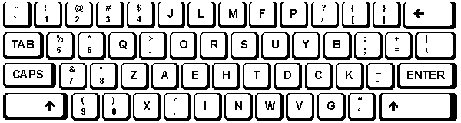
Dvorak Keyboards
Both Hands
Left Hand
Right Hand
http://www.microsoft.com/enable/products/altkeyboard.aspx
Notes:
is a keyboard layout for English patented in 1936 by August Dvorak and his brother-in-law, William Dealey, as a faster and more ergonomic alternative to the QWERTY layout (the de facto standard keyboard layout). Dvorak proponents claim that it requires less finger motion^{[2]} and as a result reduces errors, increases typing speed, reduces repetitive strain injuries,^{[3]} or is simply more comfortable than QWERTY.

Slide 22
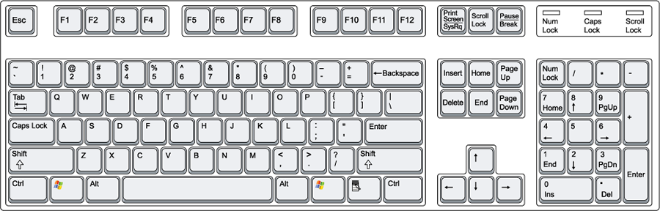
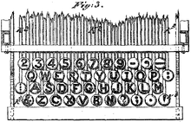
QWERTY Keyboard Layout
Latham Sholes' 1878 QWERTY keyboard layout

Slide 23
Non-standard layout and special-use
Chorded keyboard
Software or virtual keyboard
Foldable keyboard
Projection (as by Laser)

Slide 24
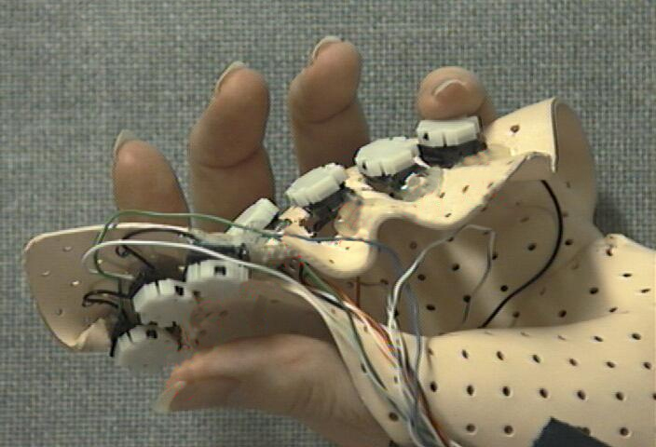
Chorded Keyboard
Associate actions with combinations of key presses
As many combinations available, chorded keyboards can effectively produce more actions on a board with fewer keys
Court reporters mostly use them
Notes:
chorded keyboard (also called a chorded keyset, chord keyboard or chording keyboard) is a computer input device that allows the user to enter characters or commands formed by pressing several keys together, like playing a "chord" on a piano. The large number of combinations available from a small number of keys allows text or commands to be entered with one hand, leaving the other hand free. A secondary advantage is that it can be built into a device (such as a pocket-sized computer or a bicycle handlebar) that is too small to contain a normal-sized keyboard.
A chorded keyboard minus the board, typically designed to be used while held in the hand, is called a keyer. Douglas Engelbart introduced the chorded keyset as a computer interface in 1968 at what is often called "The Mother of All Demos".

Slide 25
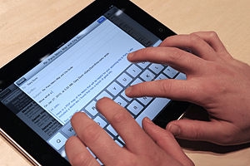
Software or Virtual Keyboards
is a software component that allows a user to enter characters.
usually be operated with multiple input devices,
Touch screen,
Actual keyboard and
Mouse.

Slide 26
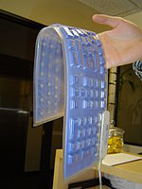
Foldable Keyboards
made of soft plastic or silicone which can be rolled or folded on itself for travel
When in use, these keyboards can conform to uneven surfaces, and
are more resistant to liquids than standard keyboards.
connected to portable devices and smart phones.

Slide 27
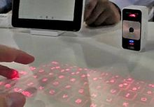
Projection Keyboard
project an image of keys, usually with a laser, onto a flat surface.
The device then uses a camera or infrared sensor to "watch" where the user's fingers move
Projection keyboards can simulate a full size keyboard from a very small projector.

Slide 28
Wireless Keyboard
provides increased user freedom
includes a required combination transmitter and receiver unit that attaches to the computer's keyboard port.
The wireless aspect is achieved either by radio frequency (RF) or by infrared (IR) signals sent and received from both the keyboard and the unit attached to the computer.
A wireless keyboard may use an industry standard RF, called Bluetooth.

Slide 29
The Mouse
All modern computers have a variant
Allows users to select objects
Pointer moved by the mouse
Mechanical mouse
Rubber ball determines direction and speed
The ball often requires cleaning
Optical mouse
Light shown onto mouse pad
Reflection determines speed and direction
Requires little maintenance

Slide 30
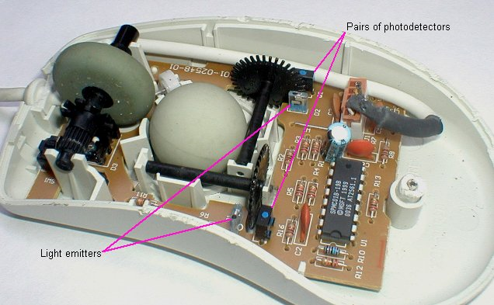
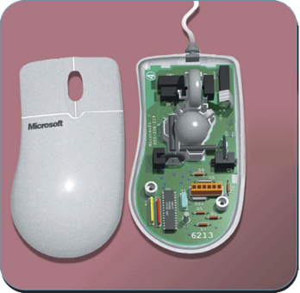
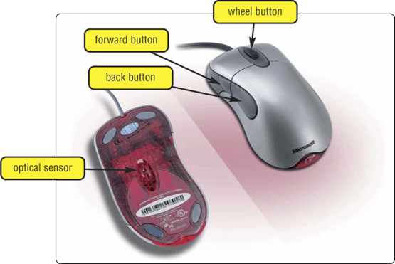
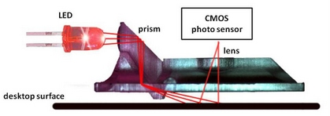
The Mouse
mouse buttons
wheel button
ball

Slide 31
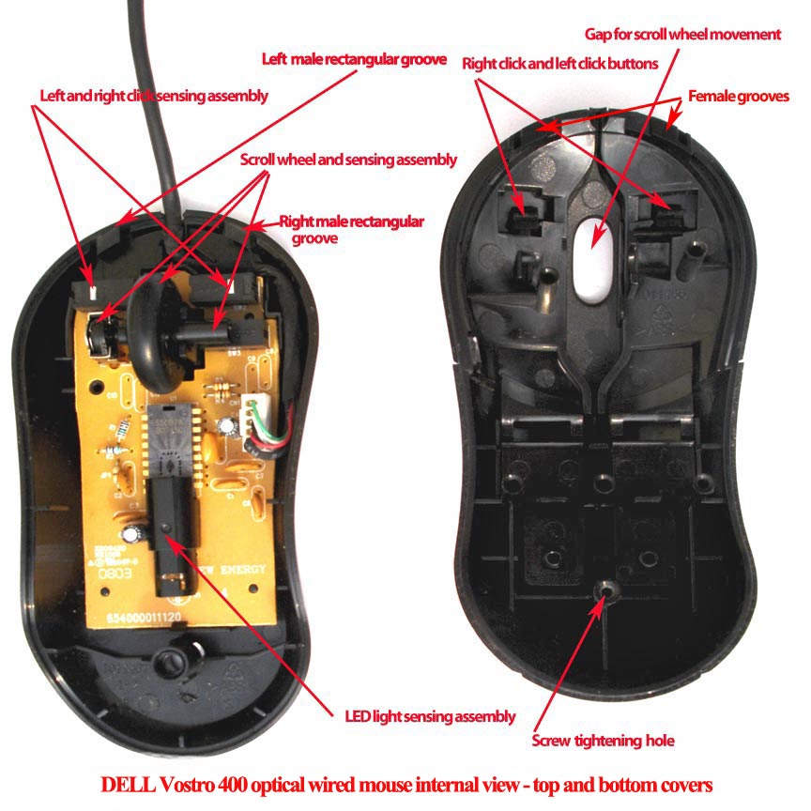
Optical Mouse

Slide 32
Benefits of Using Mouse
Pointer positioning is fast
Menu interaction is easy
Users can draw electronically

Slide 33
Interacting With a Mouse
Actions involve pointing to an object
Clicking selects the object
Double clicking the object
Clicking and holding drags the object
Releasing an object is a drop
Right clicking activates the shortcut menu
Modern mice include a scroll wheel
Notes:
Insider information
Douglas Englebart patented the first mouse in 1970 as the “X-Y position indicator for a display system.” The name mouse comes from the tail on the device.

Slide 34
Mouse Button Configuration
Configured for a right-handed user
Can be reconfigured for left handed
Between 1 and 6 buttons
Extra buttons are configurable

Slide 35
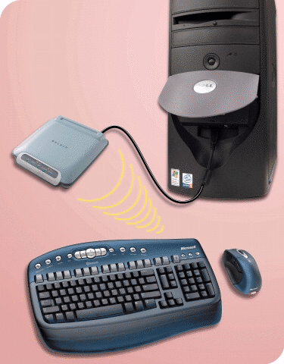
Cordless Keyboard and Mouse
Communicate with a receiver attached to a port on the system unit
Use infra-red (IR) or radio frequency (RF) technology

Slide 36
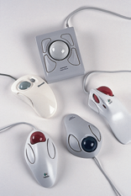
Variants of the Mouse
Trackballs
Upside down mouse
Hand rests on the ball
User moves the ball
Uses little desk space
Mostly two buttons
Can be configured for both
right-handed and
Left-handed use

Slide 37
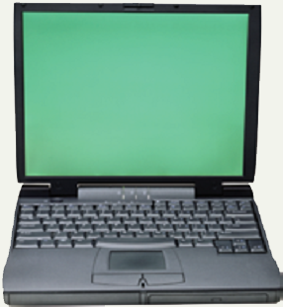
Track Pads
Stationary pointing device
Small plastic rectangle
Finger moves across the pad
Pointer moves with the pointer
Popular on laptops

Slide 38
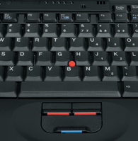
Track Point
Track point
Little joystick on the keyboard between G, H & B keys
Move pointer by moving the joystick
Two buttons beneath Spacebar same as mouse
Save great of time and effort
Notes:
Insider information
The term track point is copyrighted by IBM.

Slide 39
Summary
Standard input devices
Standard Keyboard
Five groups of Keys
How Keyboard works ?
Dvorak Keyboard
Non standard layout and Special Use
The Mouse
Five Techniques of using Mouse
Variants of Mouse

Slide 40
Recommended Websites
https://en.wikipedia.org/wiki/Computer_keyboard
https://en.wikipedia.org/wiki/Function_Keys
https://en.wikipedia.org/wiki/Chorded_keyboard
https://en.wikipedia.org/wiki/Virtual_Keyboard
https://en.wikipedia.org/wiki/Flexible_electronics
https://en.wikipedia.org/wiki/Projection_keyboard
https://en.wikipedia.org/wiki/Keyboard_technology
https://en.wikipedia.org/wiki/Computer_mouse
https://en.wikipedia.org/wiki/Trackball
https://en.wikipedia.org/wiki/Optical_mouse
https://en.wikipedia.org/wiki/Track_point

